Slide 1



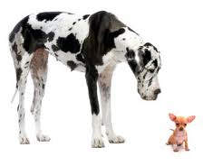
Sampling Distribution Models and the Central Limit Theorem
Transition from Data Analysis and Probability to Statistics

Slide 2
Sampling Distribution Models and the Central Limit Theorem
OBJECTIVES
At the conclusion of this unit you should be able to:
1) Derive the correct sampling distribution model when given the population parameters
2) Correctly apply the Central Limit Theorem to calculate probabilities associated with a sample proportion and sample mean

Slide 3
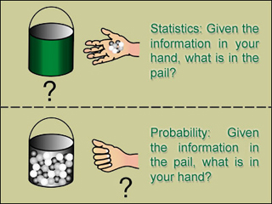
Probability:
Statistics:
From population to sample (deduction)
From sample to the population (induction)

Slide 4
Sampling Distributions
Population parameter: a numerical descriptive measure of a population.
(for example: μ, σ , p (a population proportion); the numerical value of a population parameter is usually not known)
Examples: μ = mean height of all NCSU students
p=proportion of Raleigh residents who favor stricter gun control laws
Sample statistic: a numerical descriptive measure calculated from sample data.
(e.g, x, s, p (sample proportion))

Slide 5
Parameters; Statistics
In real life parameters of populations are unknown and unknowable.
For example, the mean height of US adult (18+) men is unknown and unknowable
Rather than investigating the whole population, we take a sample, calculate a statistic related to the parameter of interest, and make an inference.
The sampling distribution of the statistic tells us how the value of the statistic varies from sample to sample.

Slide 6
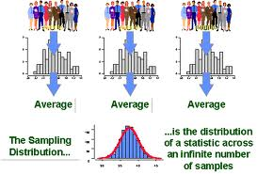
DEFINITION: Sampling Distribution
The sampling distribution of a sample statistic calculated from a sample of n measurements is the probability distribution of values taken by the statistic in all possible samples of size n taken from the same population.
Based on all possible samples of size n.

Slide 7
Constructing a Sampling Distribution
In some cases the sampling distribution can be determined exactly.
In other cases it must be approximated by using a computer to draw some of the possible samples of size n and drawing a histogram.

Slide 8
Sampling Distribution Models of Sample Proportions

Slide 9
Example: sampling distribution of p, the sample proportion
If a coin is fair the probability of a head on any toss of the coin is p = 0.5 (p is the population parameter)
Imagine tossing this fair coin 4 times and calculating the proportion p of the 4 tosses that result in heads (note that p = x/4, where x is the number of heads in 4 tosses).
Objective: determine the sampling distribution of p, the proportion of heads in 4 tosses of a fair coin.

Slide 10
Example: Sampling distribution of p
There are 2⁴ = 16 equally likely possible outcomes
(1 =head, 0 =tail)
(1,1,1,1) (1,1,1,0) (1,1,0,1) (1,0,1,1)
(0,1,1,1) (1,1,0,0) (1,0,1,0) (1,0,0,1)
(0,1,1,0) (0,1,0,1) (0,0,1,1) (1,0,0,0)
(0,1,0,0) (0,0,1,0) (0,0,0,1) (0,0,0,0)
p | 0.0 (0 heads) | 0.25 (1 head) | 0.50 (2 heads) | 0.75 (3 heads) | 1.0 (4 heads)
P(p) | 1/16= 0.0625 | 4/16= 0.25 | 6/16= 0.375 | 4/16= 0.25 | 1/16= 0.0625

Slide 11
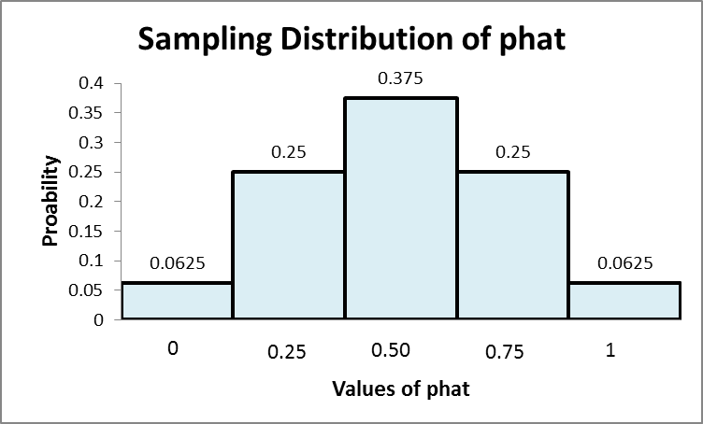
Sampling distribution of p
p | 0.0 (0 heads) | 0.25 (1 head) | 0.50 (2 heads) | 0.75 (3 heads) | 1.0 (4 heads)
P(p) | 1/16= 0.0625 | 4/16= 0.25 | 6/16= 0.375 | 4/16= 0.25 | 1/16= 0.0625

Slide 12
Sampling distribution of p (cont.)
p | 0.0 (0 heads) | 0.25 (1 head) | 0.50 (2 heads) | 0.75 (3 heads) | 1.0 (4 heads)
P(p) | 1/16= 0.0625 | 4/16= 0.25 | 6/16= 0.375 | 4/16= 0.25 | 1/16= 0.0625
E(p) =0*.0625+ 0.25*0.25+ 0.50*0.375 +0.75*0.25+ 1.0*0.0625 = 0.5 = p (the prob of heads)
Var(p) =

Slide 13
Expected Value and Standard Deviation of the Sampling Distribution of p
E(p) = p
SD(p) =
where p is the “success” probability in the sampled population and n is the sample size

Slide 14
Shape of Sampling Distribution of p
The sampling distribution of p is approximately normal when the sample size n is large enough. n large enough means np ≥ 10 and n(1-p) ≥ 10

Slide 15
Shape of Sampling Distribution of p
Population Distribution, p=.65
Sampling distribution of p for samples of size n

Slide 16
Example
8% of American Caucasian male population is color blind.
Use computer to simulate random samples of size n = 1000

Slide 17
The sampling distribution model for a sample proportion p
Provided that the sampled values are independent and the
sample size n is large enough, the sampling distribution of
p is modeled by a normal distribution with E(p) = p and
standard deviation SD(p) = , that is
where q = 1 – p and where n large enough means np>=10 and nq>=10
The Central Limit Theorem will be a formal statement of this fact.

Slide 18

Example: binge drinking by college students
Study by Harvard School of Public Health: 44% of college students binge drink.
At a particular college 244 students were surveyed; 36% admitted to binge drinking in the past week
Assume the value 0.44 given in the Harvard study is the proportion p of college students that binge drink; that is 0.44 is the population proportion p
Compute the probability that in a sample of 244 students, 36% or less have engaged in binge drinking.

Slide 19
Example: binge drinking by college students (cont.)
Let p be the proportion in a sample of 244 that engage in binge drinking.
We want to compute
E(p) = p = .44; SD(p) =
Since np = 244*.44 = 107.36 and nq = 244*.56 = 136.64 are both greater than 10, we can model the sampling distribution of p with a normal distribution, so …

Slide 20

Example: binge drinking by college students (cont.)

Slide 21


Example: snapchat by college students
recent scientifically valid survey : 77% of college students use snapchat.
1136 college students surveyed; 75% reported that they use snapchat.
Assume the value 0.77 given in the survey is the proportion p of college students that use snapchat; that is 0.77 is the population proportion p
Compute the probability that in a sample of 1136 students, 75% or less use snapchat.

Slide 22
Example: snapchat by college students (cont.)
Let p be the proportion in a sample of 1136 that use snapchat.
We want to compute
E(p) = p = .77; SD(p) =
Since np = 1136*.77 = 874.72 and nq = 1136*.23 = 261.28 are both greater than 10, we can model the sampling distribution of p with a normal distribution, so …

Slide 23


Example: snapchat by college students (cont.)

Slide 24
Sampling Distribution Models of Sample Means

Slide 25
Another Population Parameter of Frequent Interest: the Population Mean µ
To estimate the unknown value of µ, the sample mean x is often used.
We need to examine the Sampling Distribution of the Sample Mean x
(the probability distribution of all possible values of x based on a sample of size n).

Slide 26


Example
Professor Stickler has a large statistics class of over 300 students. He asked them the ages of their cars and obtained the following probability distribution:
x 2 3 4 5 6 7 8
p(x) 1/14 1/14 2/14 2/14 2/14 3/14 3/14
SRS n=2 is to be drawn from pop.
Find the sampling distribution of the sample mean x for samples of size n = 2.

Slide 27


Solution
7 possible ages (ages 2 through 8)
Total of 7²=49 possible samples of size 2
All 49 possible samples with the corresponding sample means and probabilities are on the next slide

Slide 28
All 49 possible samples of size n = 2
x 2 3 4 5 6 7 8
p(x) 1/14 1/14 2/14 2/14 2/14 3/14 3/14
Population: ages of cars and their distribution

Slide 29
Probability Distribution of the Sample Mean Age of 2 Cars
x 2 2.5 3 3.5 4 4.5 5 5.5 6 6.5 7 7.5 8
p(x) 1/196 2/196 5/196 8/196 12/196 18/196 24/196 26/196 28/196 24/196 21/196 18/196 9/196

Slide 30
Solution (cont.)
Probability distribution of x:
x 2 2.5 3 3.5 4 4.5 5 5.5 6 6.5 7 7.5 8
p(x) 1/196 2/196 5/196 8/196 12/196 18/196 24/196 26/196 28/196 24/196 21/196 18/196 1/196
This is the sampling distribution of x because it specifies the probability associated with each possible value of x
From the sampling distribution above
P(4 ≤ x ≤ 6) = p(4)+p(4.5)+p(5)+p(5.5)+p(6)
= 12/196 + 18/196 + 24/196 + 26/196 + 28/196 = 108/196

Slide 31
Expected Value and Standard Deviation of the Sampling Distribution of x

Slide 32
Example (cont.)
Population probability dist.
x 2 3 4 5 6 7 8
p(x) 1/14 1/14 2/14 2/14 2/14 3/14 3/14
Sampling dist. of x
x 2 2.5 3 3.5 4 4.5 5 5.5 6 6.5 7 7.5 8
p(x) 1/196 2/196 5/196 8/196 12/196 18/196 24/196 26/196 28/196 24/196 21/196 18/196 1/196

Slide 33
Population probability dist.
x 2 3 4 5 6 7 8
p(x) 1/14 1/14 2/14 2/14 2/14 3/14 3/14
Sampling dist. of x
x 2 2.5 3 3.5 4 4.5 5 5.5 6 6.5 7 7.5 8
p(x) 1/196 2/196 5/196 8/196 12/196 18/196 24/196 26/196 28/196 24/196 21/196 18/196 1/196
E(X)=2(1/14)+3(1/14)+4(2/14)+ … +8(3/14)=5.714
Population mean E(X)=μ = 5.714
E(X)=2(1/196)+2.5(2/196)+3(5/196)+3.5(8/196)+4(12/196)+4.5(18/196)+5(24/196)
+5.5(26/196)+6(28/196)+6.5(24/196)+7(21/196)+7.5(18/196)+8(1/196) = 5.714
Mean of sampling distribution of x: E(X) = 5.714

Slide 34
Example (cont.)

Slide 35
IMPORTANT

Slide 36
Sampling Distribution of the Sample Mean X: Example
An example
A fair 6-sided die is thrown; let X represent the number of dots showing on the upper face.
The probability distribution
of X is
Population mean μ:
μ = E(X) = 1(1/6) +2(1/6) + 3(1/6) +……… = 3.5.
Population variance σ²
σ² =V(X) = (1-3.5)²(1/6)+
(2-3.5)²(1/6)+ ………
………. = 2.92
x 1 2 3 4 5 6
p(x) 1/6 1/6 1/6 1/6 1/6 1/6

Slide 37
Suppose we want to estimate μ from the mean of a sample of size n = 2.
What is the sampling distribution of in this situation?

Slide 38
6/36
5/36
4/36
3/36
2/36
1/36
E( ) =1.0(1/36)+
1.5(2/36)+….=3.5
V(X) = (1.0-3.5)²(1/36)+
(1.5-3.5)²(2/36)... = 1.46
1 1.5 2.0 2.5 3.0 3.5 4.0 4.5 5.0 5.5 6.0

Slide 39
1
6
Notice that is smaller
than Var(X). The larger the sample
size the smaller is . Therefore,
tends to fall closer to μ, as the
sample size increases.
1
6
1
6

Slide 40
The variance of the sample mean is smaller than the variance of the population.
Mean = 1.5
Mean = 2.
Mean = 2.5
Population
1
1.5
2
2.5
1.5
2
2.5
3
1.5
2
2
2.5
1.5
2
2.5
1.5
2
2.5
Compare the variability of the population
to the variability of the sample mean.
Let us take samples
of two observations
1.5
2.5
1.5
2
2.5
1.5
2
2.5
1.5
2
2.5
1.5
2.5
1.5
2
2.5
1.5
2
2.5
1.5
2
2.5
Also,
Expected value of the population = (1 + 2 + 3)/3 = 2
Expected value of the sample mean = (1.5 + 2 + 2.5)/3 = 2

Slide 41
Properties of the Sampling Distribution of x

Slide 42
Unbiased
Unbiased
l
Confidence
l
Precision
µ
The central tendency is down the center
BUS 350 - Topic 6.1
Handout 6.1, Page 1
6.1 -
14

Slide 44
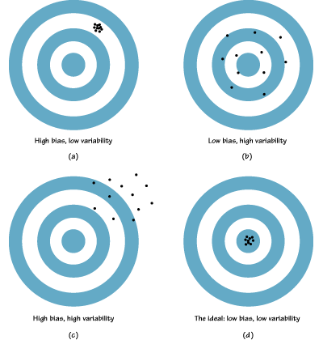

Slide 45
Consequences

Slide 46

A Billion Dollar Mistake
“Conventional” wisdom: smaller schools better than larger schools
Late 90’s, Gates Foundation, Annenberg Foundation, Carnegie Foundation
Among the 50 top-scoring Pennsylvania elementary schools 6 (12%) were from the smallest 3% of the schools
But …, they didn’t notice …
Among the 50 lowest-scoring Pennsylvania elementary schools 9 (18%) were from the smallest 3% of the schools

Slide 47


A Billion Dollar Mistake (cont.)
Smaller schools have (by definition) smaller n’s.
When n is small, SD(x) = is larger
That is, the sampling distributions of small school mean scores have larger SD’s

Slide 48
We Know More!
We know 2 parameters of the sampling distribution of x :

Slide 49

THE CENTRAL LIMIT THEOREM
The “World is Normal” Theorem

Slide 50
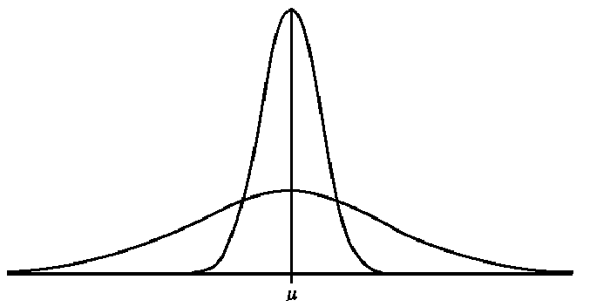
But first,…Sampling Distribution of x- Normally Distributed Population
Sampling distribution of x:
N(μ , σ /√10)
n=10
σ/√10
Population distribution:
N(μ , σ)
σ

Slide 51
Normal Populations
Important Fact:
If the population is normally distributed, then the sampling distribution of x is normally distributed for any sample size n.
Previous slide

Slide 52
Non-normal Populations
What can we say about the shape of the sampling distribution of x when the population from which the sample is selected is not normal?

Slide 53
The Central Limit Theorem (for the sample mean x)
If a random sample of n observations is selected from a population (any population), then when n is sufficiently large, the sampling distribution of x will be approximately normal.
(The larger the sample size, the better will be the normal approximation to the sampling distribution of x.)

Slide 54
The Importance of the Central Limit Theorem
When we select simple random samples of size n, the sample means will vary from sample to sample. We can model the distribution of these sample means with a probability model that is …

Slide 55
How Large Should n Be?
For the purpose of applying the Central Limit Theorem, we will consider a sample size to be large when n > 30.
←
←
←
Even if the population from which the sample is selected looks like this …
… the Central Limit Theorem tells us that a good model for the sampling distribution of the sample mean x is …
→
→
→

Slide 56
Summary
Population: mean μ; stand dev. σ; shape of population dist. is unknown; value of μ is unknown; select random sample of size n;
Sampling distribution of x:
mean μ; stand. dev. σ/√n;
always true!
By the Central Limit Theorem:
the shape of the sampling distribution is approx normal, that is
x ~ N(μ, σ/√n)

Slide 57
The Central Limit Theorem (for the sample proportion p )
If x “successes” occur in a random sample of n observations selected from a population (any population), then when n is sufficiently large, the sampling distribution of p =x/n will be approximately normal.
(The larger the sample size, the better will be the normal approximation to the sampling distribution of p.)

Slide 58
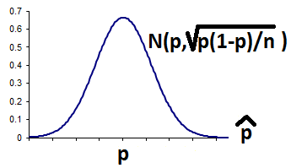
The Importance of the Central Limit Theorem
When we select simple random samples of size n from a population with “success” probability p and observe x “successes”, the sample proportions p =x/n will vary from sample to sample. We can model the distribution of these sample proportions with a probability model that is…

Slide 59
How Large Should n Be?
For the purpose of applying the central limit theorem, we will consider a sample size n to be large when np ≥ 10 and n(1-p) ≥ 10
←
←
←
If the population from which the sample is selected looks like this …
… the Central Limit Theorem tells us that a good model for the sampling distribution of the sample proportion is …
→
→
→

Slide 60
Population Parameters and Sample Statistics
The value of a population parameter is a fixed number, it is NOT random; its value is not known.
The value of a sample statistic is calculated from sample data
The value of a sample statistic will vary from sample to sample (sampling distributions)
Population parameter | Value | Sample statistic used to estimate
p proportion of population with a certain characteristic | Unknown
µ mean value of a population variable | Unknown

Slide 61
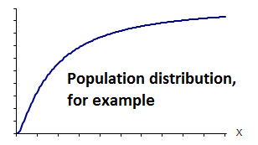
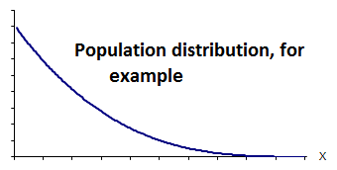
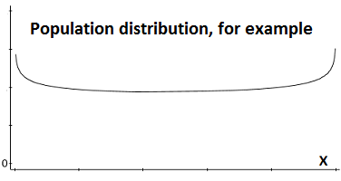
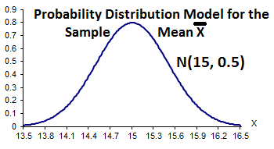
Example

Slide 62
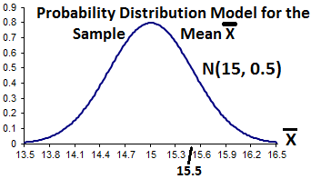
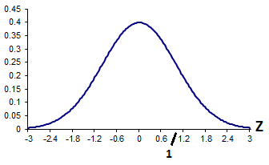
Example (cont.)

Slide 63
Example 2
The probability distribution of 6-month incomes of account executives has mean $20,000 and standard deviation $5,000.
a) A single executive’s income is $20,000. Can it be said that this executive’s income exceeds 50% of all account executive incomes?
ANSWER No. P(X<$20,000)=? No information given about shape of distribution of X; we do not know the median of 6-month incomes.

Slide 64
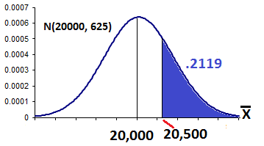
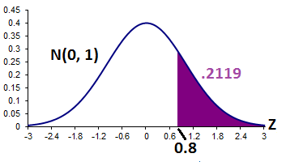
Example 2(cont.)
b) n=64 account executives are randomly selected. What is the probability that the sample mean exceeds $20,500?

Slide 65
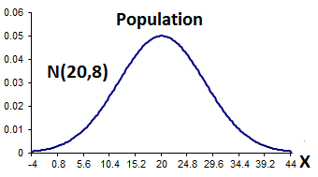
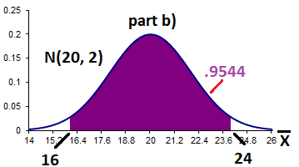
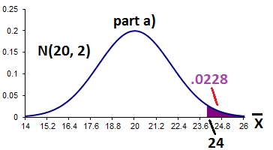
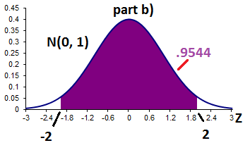
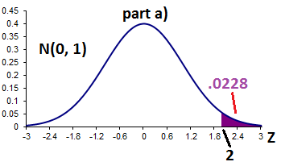
Example 3
A sample of size n=16 is drawn from a normally distributed population with
E(X)=20 and SD(X)=8.

Slide 66
Example 3 (cont.)
c. Do we need the Central Limit Theorem to solve part a or part b?
NO. We are given that the population is normal, so the sampling distribution of the mean will also be normal for any sample size n. The CLT is not needed.

Slide 67
Example 4
Battery life X~N(20, 10). Guarantee: avg. battery life in a case of 24 exceeds 16 hrs. Find the probability that a randomly selected case meets the guarantee.

Slide 68
Example 5
Cans of salmon are supposed to have a net weight of 6 oz. The canner says that the net weight is a random variable with mean μ=6.05 oz. and stand. dev. σ=.18 oz.
Suppose you take a random sample of 36 cans and calculate the sample mean weight to be 5.97 oz.
Find the probability that the mean weight of the sample is less than or equal to 5.97 oz.

Slide 69
Population X: amount of salmon in a can E(x)=6.05 oz, SD(x) = .18 oz
X sampling dist: E(x)=6.05 SD(x)=.18/6=.03
By the CLT, X sampling dist is approx. normal
P(X ≤ 5.97) = P(z ≤ [5.97-6.05]/.03)
=P(z ≤ -.08/.03)=P(z ≤ -2.67)= .0038
How could you use this answer?

Slide 70
Suppose you work for a “consumer watchdog” group
If you sampled the weights of 36 cans and obtained a sample mean x ≤ 5.97 oz., what would you think?
Since P( x ≤ 5.97) = .0038, either
you observed a “rare” event (recall: 5.97 oz is 2.67 stand. dev. below the mean) and the mean fill E(x) is in fact 6.05 oz. (the value claimed by the canner)
the true mean fill is less than 6.05 oz., (the canner is lying ).

Slide 71
Example 6
X: weekly income. E(X)=1050, SD(X) = 100
n=64; X sampling dist: E(X)=1050 SD(X)=100/8 =12.5
P(X ≤ 1022)=P(z ≤ [1022-1050]/12.5)
=P(z ≤ -28/12.5)=P(z ≤ -2.24) = .0125
Suspicious of claim that average is $1050; evidence is that average income is less.

Slide 72
Example 7
12% of students at NCSU are left-handed. What is the probability that in a sample of 100 students, the sample proportion that are left-handed is less than 11%?

Slide 73
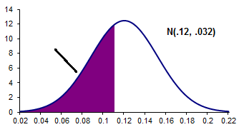
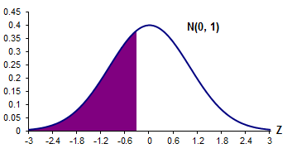
Example 7 (cont.)

